Slide 1


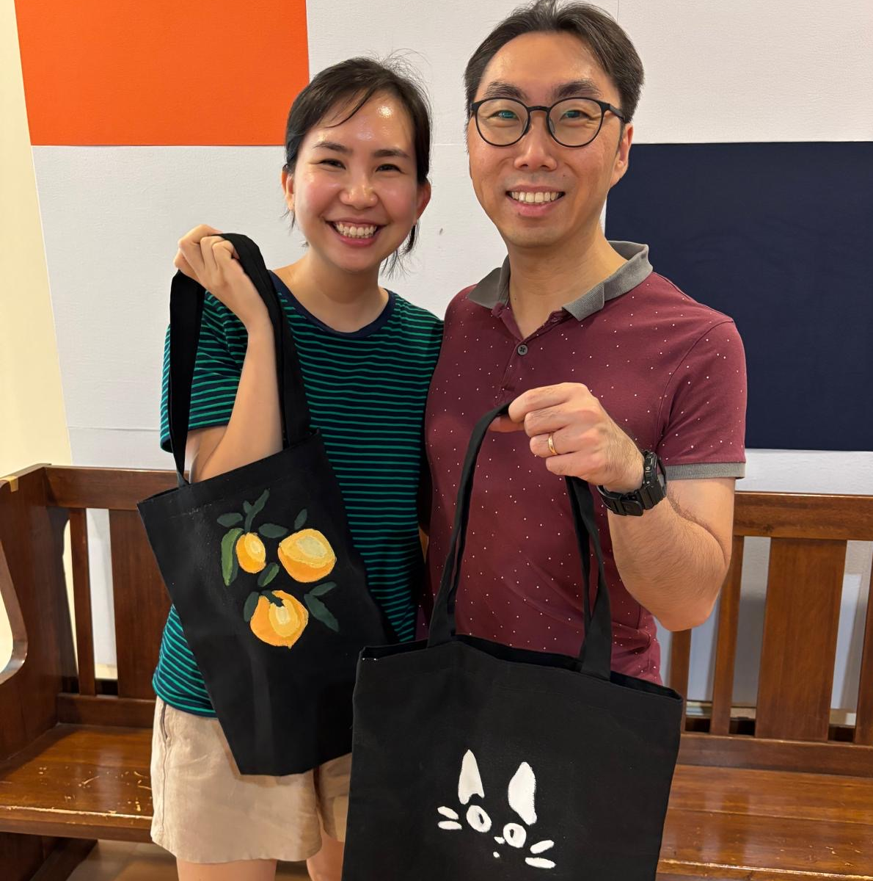
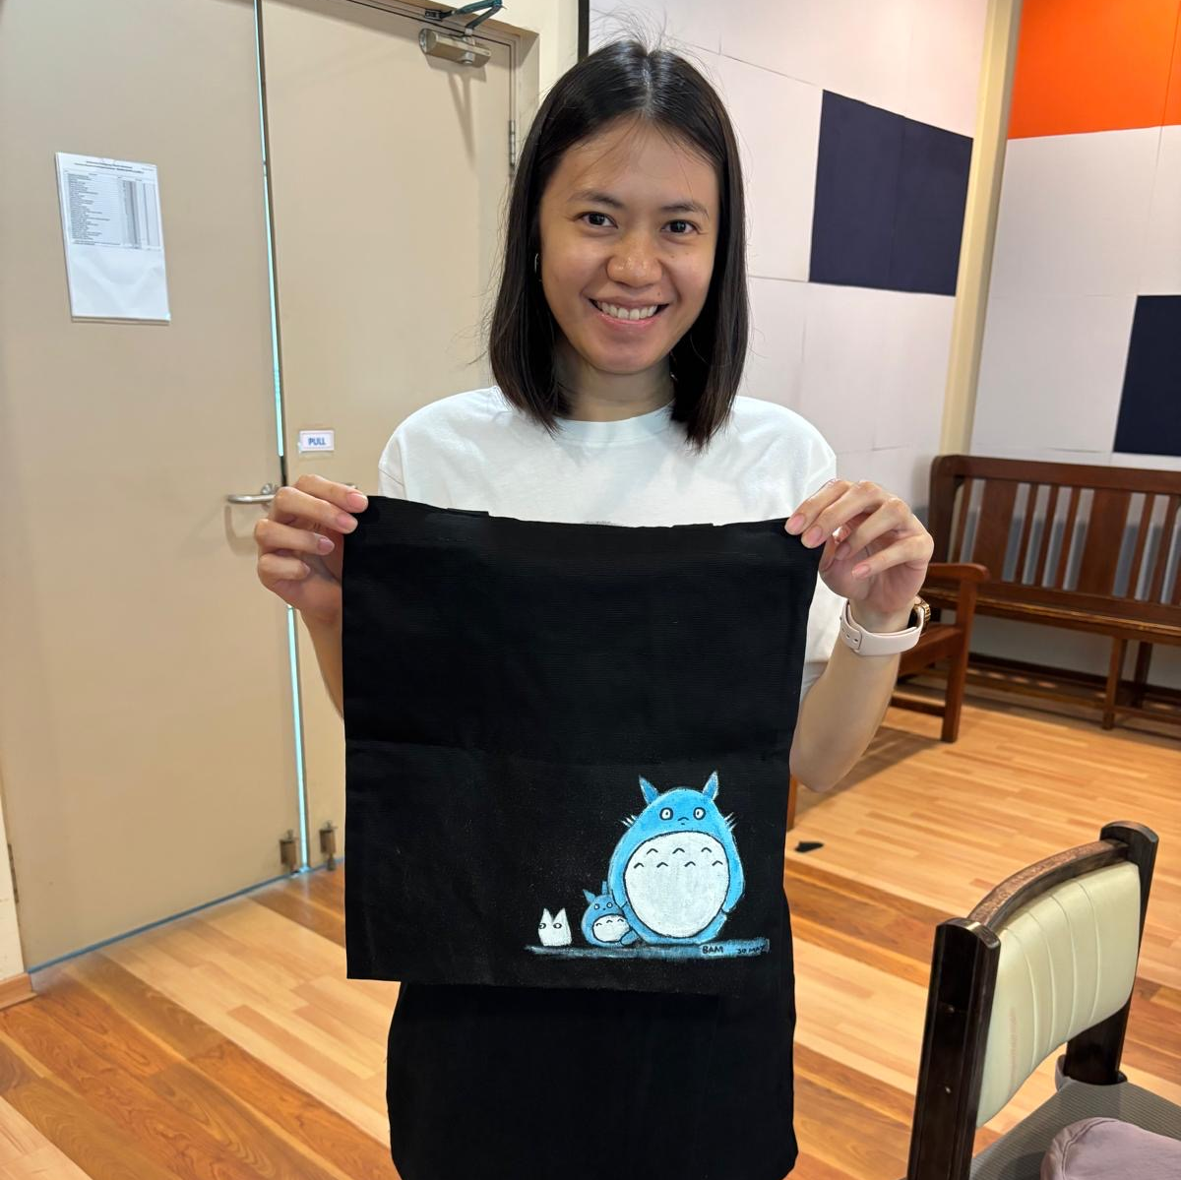
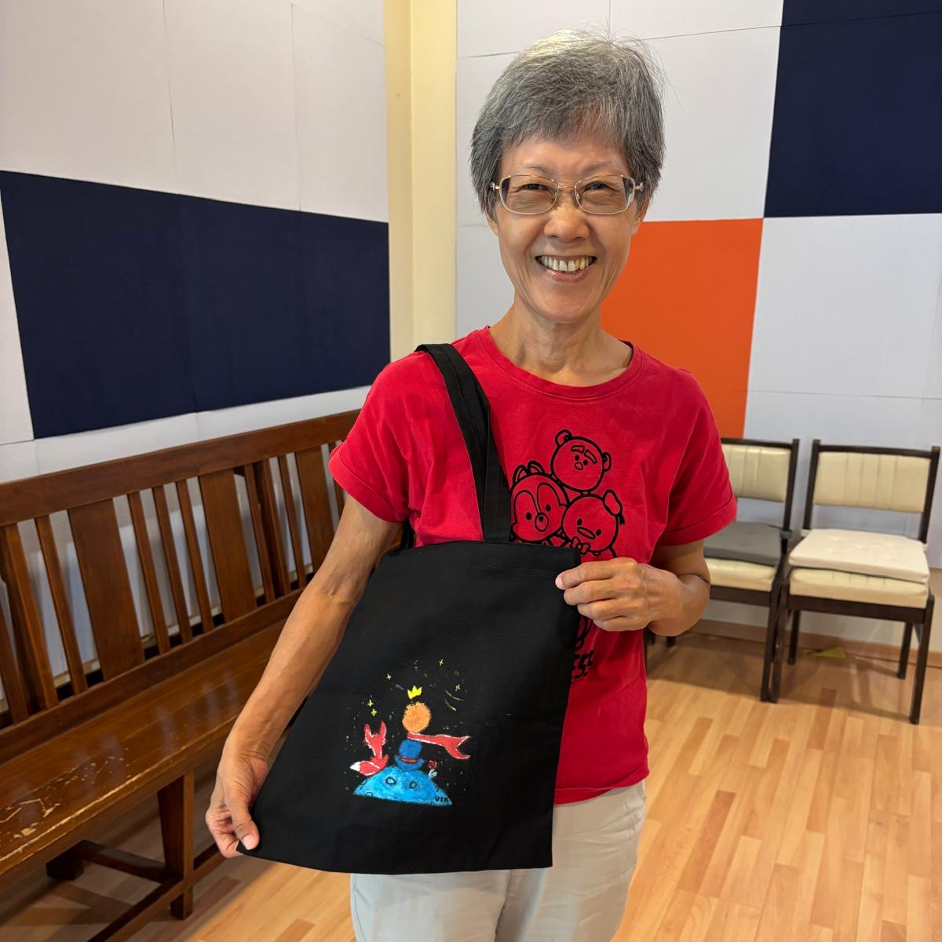
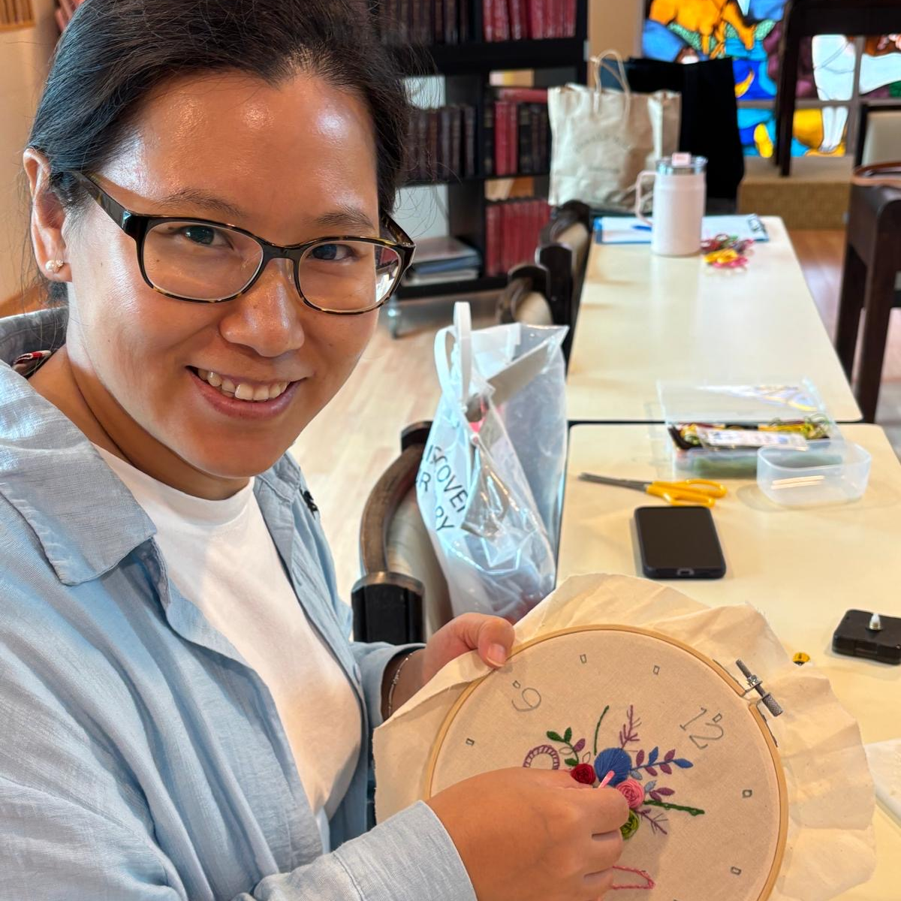
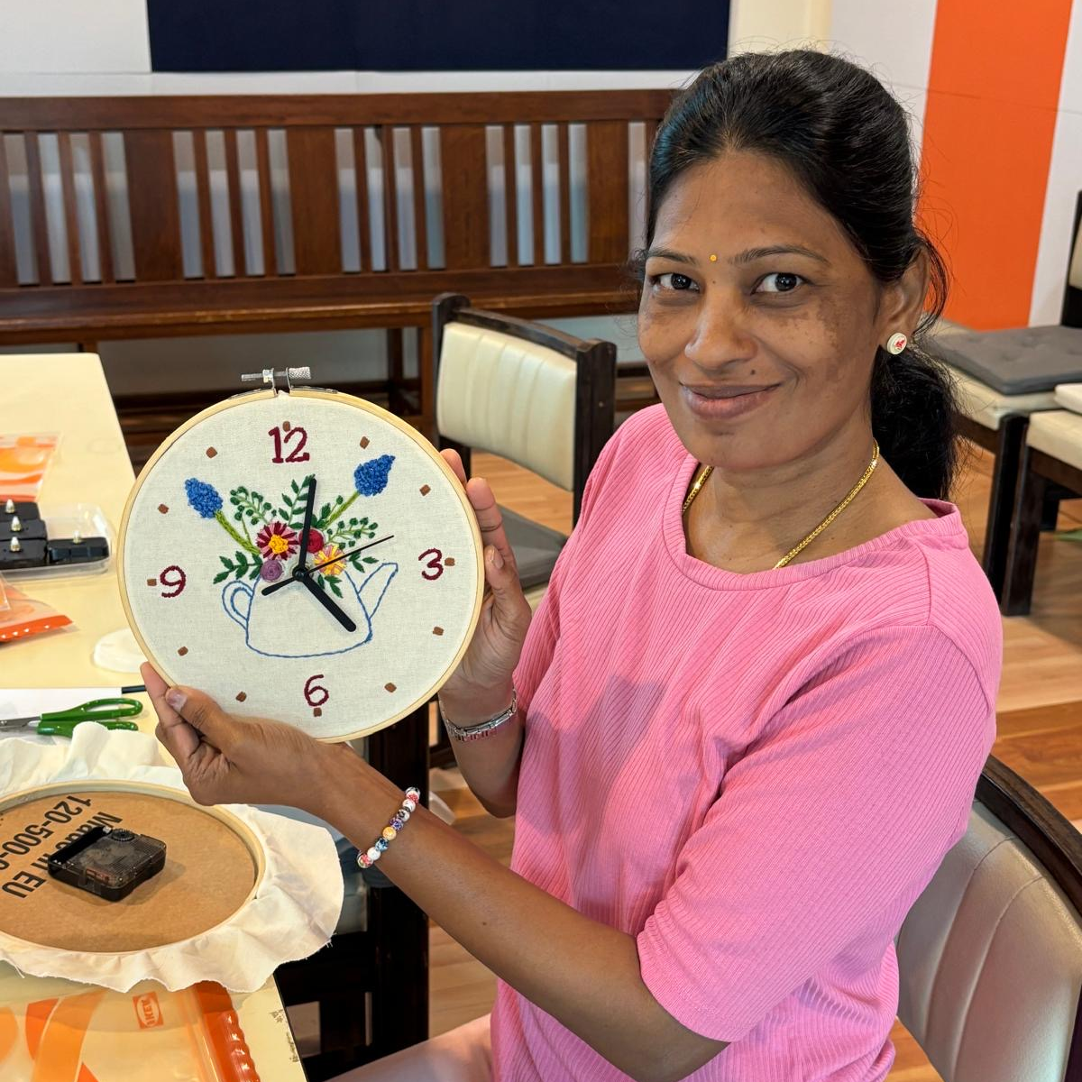
Graceful Bonds News
UPCOMING EVENTS
Jul
25
Diamond Dots Project
4.00pm to 5.30pm
MY EXPERIENCE
Sheena Mae Santos - parent of Santiago, (K2)
Mangalam Vijayakumar - parent of Sugan, (K1)
“I recently had the pleasure of participating in the Graceful Bonds art workshop, and it was truly a heartwarming and enriching experience.
The event created a welcoming and relaxed environment where parents could connect through creativity. I deeply appreciate the school’s initiative to host such events that nurture relationships and provide a creative outlet for parents, guardians and family members.
Looking forward to more such moments of shared joy and creativity!”
“Graceful Bonds was more than just an activity - it was a deeply moving experience. It allowed me to connect not only with others but also with myself on a level I hadn’t expected. The atmosphere was calm, and beautifully structured to encourage our team ”

